Slide 1







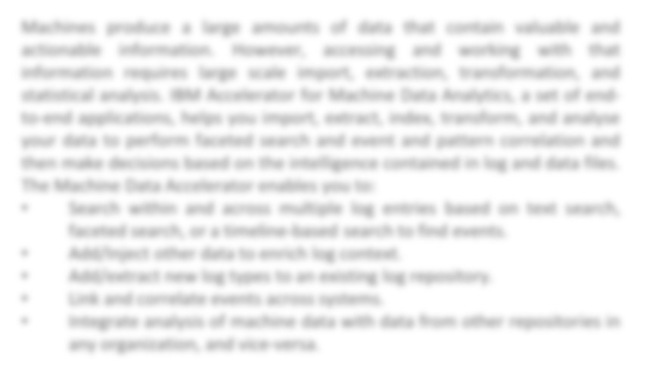






Title of the Project
Student List (Name & Regno.)
Under the guidance of ----------------------------------, Work done at VIT University, Chennai
B.Tech Computer Science Engineering (2015-2016)
SCHOOL OF COMPUTING SCIENCE & ENGINEERING, VIT UNIVERSITY
INTRODUCTION
LITERATURE SURVEY
METHODS & TECHNOLOGIES
•
RESULTS AND OBSERVATIONS:
WORKFLOW/ARCHITECTURE DIAGRAM/SYSTEM DESIGN
OBJECTIVE
REFERENCES

